Slide 1

BACKUP AND RECOVERY CONCEPTS
ORACLE DBA ONLINE TRAINING

Slide 2
Basics of Backup and Recovery
As a DBA, you are the person responsible for recovering the data and guarding the business continuity of your organization
DBA have the key responsibility for developing, deploying, and managing an efficient backup and recovery strategy for your institution or clients that will allow them to easily recover from any possible disastrous situation.
Main purpose of taking backup is to protect data to avoid below mentioned situations:
Media failure:
Media failure occurs when a system is unable to write or read from a physical storage device
Hardware failure:
Hardware failure is when a failure occurs on a physical component of your hardware such as when your server motherboard, CPU, or any other component stops working
Human error:
Human error, also known as user error, is when a user interacting directly or through an application causes damage to the data stored in the database or to the database itself. The most frequent examples of human error involve changing or deleting data and even files by mistake. It is likely that this kind of error is the greatest single cause of database downtime in a company
Application error:
An application error happens when a software malfunction causes data corruption in the logical or physical levels. A bug in the code can easily damage data or even corrupt a data block. This kind of problem can be solved using Oracle block media recovery and is why it is so important to have a proper test done prior to promoting an application change to any production environment.

Slide 3
Types of backup
A backup is a real and consistent copy of data from a database that could be used to reconstruct the data after an incident. There are two different types of backups available, which are:
Physical backup:
Physical backup is a copy of all the physical database files that are required to perform the recovery of a database. These include datafiles, control files, parameter files, and archived redo log files. As an Oracle DBA, we have different options to make a physical backup of our database. Backups can be taken using user-managed backup techniques or using Recovery Manager (RMAN).
Logical backup:
Oracle uses Oracle Data Pump to allow you to generate a logical backup that can be used to migrate data or even do a partial or full recovery of our database. The utilities available are the Data Pump Export program (expdp/exp) and the Data Pump Import program (impdp/imp).

Slide 4
Restore versus recovery
Restore: It is the act that involves the restoration of all files that will be required to recover your database to a consistent state, for example, copying all backup files from a secondary location such as tape or storage to your stage area
Recovery: It is the process to apply all transactions recorded in your archive logs, rolling your database forward to a point-in-time or until the last transaction recorded is applied, thus recovering your database to the point-in-time you need

Slide 5
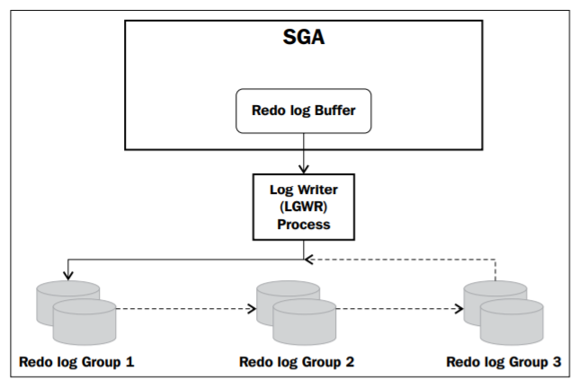
Important terms related to backup & Recovery
What is redo? Oracle blocks (the smallest unit of storage in a database) are changed, including UNDO blocks, Oracle records the changes in the form of vector changes, which are referred to as redo entries or redo records. Redo log files protect the database from loss of integrity due to system failures caused by power outages, disk failures, and so on.
The redo entries are written by the LGWR to a disk when:
A user issues a commit
The log buffer is one third full
The amount of unwritten redo entries is 1 MB
When a database checkpoint takes place
Otherwise, every three seconds
Redo log files must be multiplexed using different disks (use of fast disk is preferred) to ensure that the information stored in them is not lost in the event of a disk failure.

Slide 6
The NOARCHIVELOG mode
When your database is created by default, it will be created using the NOARCHIVELOG mode. This mode permits any normal database operations but will not provide your database with the capability to perform any point-in-time recovery operations or online backups of your database.
When the database is using this mode, no hot backup is possible (hot backup is any backup done with the database open, causing no interruption for the users). You will only be able to perform backups with your database down (shutdown, also known as the offline backup or the cold backup), and you will only be able to perform a full recovery up to the point that your backup was made

Slide 7
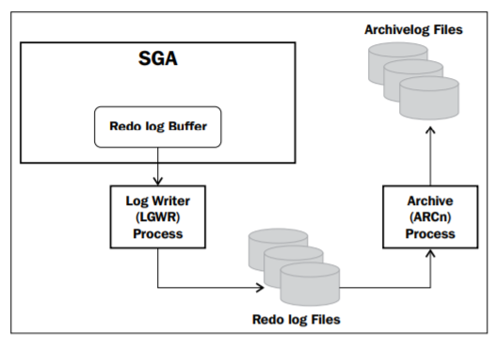
The ARCHIVELOG mode
Oracle lets you save filled redo log files to one or more offline destinations to improve the recoverability of your data by having all transactions saved in case of a crash, reducing any possibility of data loss.
The copy of the redo log file containing transactions against your database made to a different location is known as an ARCHIVELOG file, and the process of turning redo log files into archived redo log files is called archiving.

Slide 8
Placing a database into the ARCHIVELOG mode
Set up the size of your FRA to be used by your database. You can do this by using the command:
SQL> ALTER SYSTEM SET DB_RECOVERY_FILE_DEST_SIZE= SCOPE=both;
Specify the location of the FRA using the command:
SQL> ALTER SYSTEM SET DB_RECOVERY_FILE_DEST= '/u01/app/oracle/fast_recovery_area' scope=both;
Define your archive log destination area using the command:
SQL> ALTER SYSTEM SET log_archive_dest_1= 'LOCATION=/DB/u02/backups/archivelog' scope=both;
Define your secondary archive log area to use the FRA with the command:
SQL> ALTER SYSTEM SET log_archive_dest_10= 'LOCATION=USE_DB_RECOVERY_FILE_DEST’;
Shutdown your database using the command:
SQL> SHUTDOWN IMMEDIATE
Start your database in mount mode using the command:
SQL> STARTUP MOUNT
Switch your database to use the ARCHIVELOG mode using the command:
SQL> ALTER DATABASE ARCHIVELOG;
Then finally open your database using the command:
SQL> ALTER DATABASE OPEN;

Slide 9
User-managed Backup and Recovery
User-managed backups are basically all the backups which you can take without using RMAN. Moreover, no automatic metadata record of the backup is generated anywhere in the database. Therefore, you must always keep records of what you backed up and where.
Before you start a user-managed backup, you will always need to know first:
1. Where all your datafiles are located and their names. (SELECT name FROM v$datafile; )
2. Where your archive logs are located. (Archive log list)
3. Where your control file is located. (SELECT name FROM v$controlfile;)
4. And finally where your SPFILE or PFILE is located. (Show parameter spfile)

Slide 10
USER MANAGED backup - COLD BACKUP
cold backups are the only possible way for a DBA to perform a consistent backup of a database independent of the mode your database is running.
You can easily perform a manual backup of your database with the database down by following these simple steps:
If your database is OPEN, then shut down your database completely in a consistent mode (use SHUTDOWN [NORMAL/IMMEDIATE/TRANSACTIONAL] only). This will ensure that all the database file headers are consistent to the same SCN
Backup all the database datafiles, control files, and the PFILE or SPFILE (copying them to a stage area on the operating system level):
Example: cp $ORACLE_BASE/oradata/cdb1/*.dbf /stage/backup
Restart the database
Archive all unachieved redo logs so any redo required to recover the tablespace is archived and executes a backup of all the archive log files:
SQL> ALTER SYSTEM ARCHIVE LOG CURRENT;
cp $ORACLE_BASE/fast_recovery_area/*.arc /stage/backup

Slide 11
USER MANAGED BACKUP – OFFLINE backup
If what you need to perform an offline backup of one or more tablespaces, you should first notice that you cannot take the SYSTEM tablespace or a tablespace with any active UNDO segments offline. Also, when using this method always take into consideration whether the tablespace is completely self-contained before performing this type of backup, in other words, you should first check if any logical or physical dependencies between objects exist first:
1. Identify all the datafiles associated with a tablespace by querying the DBA_DATA_FILES view:
SQL> SELECT tablespace_name, file_name FROM sys.dba_data_files WHERE tablespace_name = 'EXAMPLE’;
2 Take the tablespace offline using the NORMAL priority if possible (this guarantees that no recovery will be necessary when bringing the tablespace online later):
SQL> ALTER TABLESPACE example OFFLINE NORMAL;
3. Backup all datafiles related to the now offline tablespace via the OS:
cp $ORACLE_BASE/oradata/cdb1/pdb1/example_01.dbf /stage/backup
4. Bring the tablespaces online:
SQL> ALTER TABLESPACE example ONLINE;
5. Archive all unachieved redo logs so any redo required to recover the tablespace is archived and executes a backup of all archive log files:
SQL> ALTER SYSTEM ARCHIVE LOG CURRENT;
cp $ORACLE_BASE/fast_recovery_area/*.arc /stage/backup

Slide 12
USER MANAGED backup - Hot backups
Oracle introduced hot backups back in version 6, allowing us take hot backups of our database tablespaces without the need to shut down the database like in earlier versions.
Oracle gave us the ability to take hot backups of the entire database, making our life a little easier. When executing a user-managed backup online, Oracle stops recording checkpoints to all the associated datafiles.
Let's take a deeper look at what's happening internally in the database when we use the BEGIN BACKUP option: •
A hot backup flag in the datafiles header is set
A checkpoint occurs, flashing all dirty blocks from memory to disk, synchronizing all the datafile headers to the same SCN, and freezing the headers for consistency, protection, and recoverability
Hot backups (inconsistent backups due to fractured data blocks) can be made to the whole database, a tablespace or even at container level and it will require a recovery process after the backup is restored. Due to this, it is very important to always ensure that all your archive log files are being backed up.

Slide 13
Hot backups
Hot backup of a whole database
Hot backup of tablespaces
Whole container database
Root only or individual pluggable database

Slide 14
Hot backup of a whole database
Place your entire database in backup mode:
SQL> ALTER DATABASE BEGIN BACKUP;
Backup all datafiles and the PFILE or SPFILE strings. This backup is a simple physical copy of files at the OS level:
cp $ORACLE_BASE/oradata/cdb1/*.dbf /stage/backup
Take the database out of backup mode:
SQL> ALTER DATABASE END BACKUP;
Archive all unachieved redo logs so any redo required to recover the database is archived:
SQL> ALTER SYSTEM ARCHIVE LOG CURRENT;
Make a backup of all archived redo log files (OS level):
cp $ORACLE_BASE/fast_recovery_area/*.arc /stage/backup
Create a copy of your control file using the ALTER DATABASE statement:
SQL> ALTER DATABASE BACKUP CONTROLFILE TO'/stage/backup/control.ctf';

Slide 15
Hot backup of tablespaces
To do an online backup of one or more tablespaces, you just need to follow these simple steps:
Identify all the datafiles associated with the tablespace by querying the dba_data_files view:
SQL> SELECT tablespace_name, file_name 2 FROM sys.dba_data_files 3 WHERE tablespace_name = 'EXAMPLE’;
2. Place the tablespace in backup mode:
SQL> ALTER TABLESPACE example BEGIN BACKUP;
cp $ORACLE_BASE/oradata/cdb1/pdb1/example_01.dbf /stage/backup
3. Place the tablespace back in the normal mode:
SQL> ALTER TABLESPACE example END BACKUP;

Slide 16
Control file backup
Having a valid backup of the control file of a database is crucial for the successful recovery of a database. Due to this we will take a closer look at the available methods to make a user-managed backup of a control file.
1. Binary backup: You can generate a binary copy of the control file via a simple SQL statement.
ALTER DATABASE BACKUP CONTROLFILE TO ‘[filename_including_location] ‘;
2. Text file backup: You can generate a text file that contains a CREATE CONTROLFILE statement based on the current control file in use by the database via a simple SQL statement that can be executed on a database in the MOUNT or OPEN state.
ALTER DATABASE BACKUP CONTROLFILE TO TRACE AS '/stage/backup/ctlf.sql';

Slide 17
Recovering from a user-managed backup
When recovering a database in the ARCHIVELOG mode, you can do it using an online or offline backup, depending on the type of backup strategy you are currently using in your environment. When recovering from a user-managed backup, you will be able to recover the database up to the point that the failure occurred, and you can choose to recover the database to a specific point in time based on date and time or using a SCN.
When doing a recovery of a database in the ARCHIVELOG mode you will be also able to make a recovery of:
Datafiles, Tablespaces Or the entire database.
To perform a full database recovery from a backup of a database in the ARCHIVELOG mode, follow these steps:
1. Restore all the database datafiles from your backup.
2. Restore all the backed up archived redo logs.
3. Mount the database (using the STARTUP MOUNT command).
4. Recover the database (using the RECOVER DATABASE command).
5. Oracle will prompt you to apply redo from the archived redo logs. Simply enter AUTO at the prompt and it will automatically apply all the redo logs for you.
6. Once all the redo logs are applied, open the recovered database (using the ALTER DATABASE OPEN command).

Slide 18
Recovering from a user-managed backup
The full recovery of tablespaces and datafiles can be performed with the database mounted or open.
1. Make the tablespace offline (using the ALTER TABLESPACE OFFLINE IMMEDIATE command).
2. Restore all the datafiles associated with the tablespace to be recovered.
3. Recover the tablespace (using the RECOVER TABLESPACE command).
4. Once the recovery has been completed, make the tablespace online (using the ALTER TABLESPACE ONLINE command).
You can use the following steps to recover some specific datafiles without taking the tablespace offline:
1.Make the datafile offline (using the ALTER DATABASE DATAFILE OFFLINE command).
2. Restore all the datafiles to be recovered.
3. Recover the datafile (using the RECOVER DATAFILE command).
4. Once the recovery has been completed, make the datafile online (using the ALTER DATABASE DATAFILE ONLINE command).

Slide 19
A point-in-time recovery
A point-in-time recovery can be used to recover a database up to a specific point in time. Most of the time this is used to recover the database until just before a major failure or crash happens. It is also used to clone a database for test or development purpose.
If you want to recover a tablespace to a specific point in time, you will need to recover the entire database to the same point in time unless you perform a tablespace point-in-time recovery (TSPITR)
To recover your database to a point in time (DBPITR)
you will just need to follow these steps:
1. Restore all database datafiles from a previous backup made before the point-in-time that you want to recover the database from.
2. Recover the database to the point-in-time using the RECOVER DATABASE UNTIL TIME 'April 18 2021 09:00:00' command and apply the archive logs as required.
3. When the recovery is completed, open the database using the ALTER DATABASE OPEN RESETLOGS command.
You can also choose to do your DBPITR using an SCN

Slide 20
USER MANAGED - recovery scenarios
Losing all copies of the current control file:
If you have lost all the copies of your current control file, you will need to restore a backup of the control file and perform an incomplete recovery, opening the database with the RESETLOGS option. If you do not have a current backup of the control file, you can attempt to re-create the control file by using a previous backup (if available) of the script generated by the ALTER DATABASE BACKUP CONTROLFILE TO TRACE command (and edit it to include any changes made to the database structure since the script was generated) to re-create the control file. If not available, create a new script (from another database) and match the control file structure in the script with the current database structure.
Losing one copy of a multiplexed control file:
If you have lost one copy of a multiplexed control file, you will need to copy one of the surviving copies of the multiplexed control file into the location of the lost/ damaged control file and open the database. If the original location is inaccessible, then all you need to do is copy one of the surviving copies to a new location and edit the initialization parameter file to reflect the change, then open the database.

Slide 21
USER MANAGED - recovery scenarios
Loss of archived redo logs or online redo logs:
If you need to perform a recovery of your database and discover that you have lost one or more archived redo logs that makes impossible to perform a complete recovery, then you will need to perform some form of point-in-time recovery (incomplete recovery) to allow you to recover your database with the data you have available. In the case of losing of the current online redo log file, perform the recovery using the UNTIL CANCEL option, then open your database using the RESETLOGS command.
Loss of SPFILE:
If you lose your current SPFILE or PFILE and your database is up and running, then all you will need to do is execute the CREATE FROM MEMORY command to re-create it. If the database is down then you will need to restore it from a previous backup. Another option available if you have a current copy of the SPFILE as PFILE (created by using the CREATE PFILE FROM SPFILE statement in SQL*Plus) is to start the instance using the PFILE, then re-create the SPFILE using the CREATE SPFILE FROM PFILE statement, and finally re-start your database.

Slide 22
RMAn Utility for BACKUP
Benefits of using RMAN instead of user managed backup:
RMAN provides a single backup standard for the entire enterprise
RMAN is supplied with the database software and so using it doesn't need any additional licensing to be purchased.
Backups can easily be automated using RMAN scripts
RMAN is integrated with the Oracle Database kernel and thus is very efficient. This further implies that for the purpose of data recovery, you have one infrastructure application less to install before beginning recoveries.
RMAN provides efficient backup metadata management as it is maintained within the control file of the target database itself. The control file uses parameters to mark the metadata as obsolete at respective internals, thus making space for new data.
RMAN allows you to garner reports for backup management such as listing available backups, their status and availability, and listing the files which need to be backed up, through simple commands such as LIST, REPORT, and so forth.
RMAN facilitates the use of the Recovery Catalog, which is an optional location to store metadata for multiple databases.
RMAN enables us to secure incremental backups whereby we can take a backup of the changes made to the database rather than the entire database. This feature expedites data recovery and improves backup time, thus reducing strain on the infrastructure.
RMAN has in-built compression techniques to reduce the size of the backups created through it
Using RMAN, advanced tasks such as cloning of databases becomes extremely easy.
Only RMAN offers the detection and recovery of corrupted blocks without asking for any downtime either for the table or for the database
RMAN doesn't restrict you to work with only itself. It can be used along with third-party solutions such as Tivoli and Netbackup as well.

Slide 23
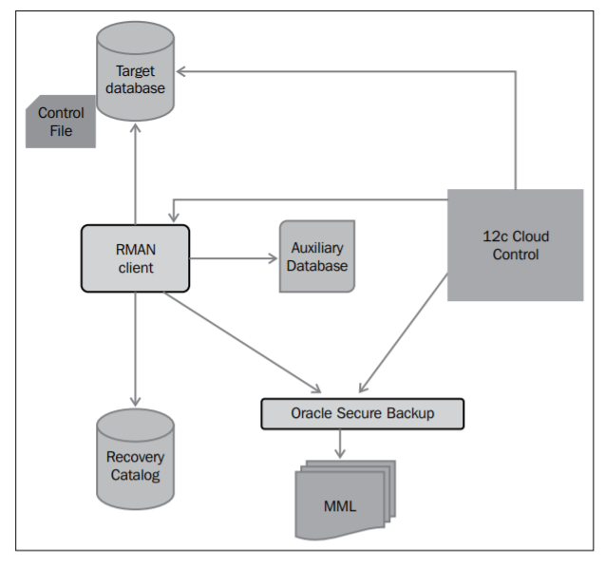
RMAN architecture
There are a few key entities for RMAN to start with. Some of them are mandatory and the rest are optional. We will list these components along with whether they are optional or mandatory in the following list:
Target database (mandatory)
Target Control File (mandatory)
Channels (mandatory)
Recovery Catalog (optional)
Oracle Secure Backup (optional)
Media Management Library (optional)
Auxiliary database (optional)
Cloud Control 12c/13c (optional)

Slide 24
RMAN backup formats and types
There are two formats of backup supported in RMAN:
1. Backup set
2. Image copy
Using RMAN we can mainly take two types of Backup:
Full backup
Incremental backup
Further, the incremental backups can be of two types, namely cumulative and differential backups

